Slide 1

Job Market Analysis
Presented by Florence C Tungoe

Slide 2

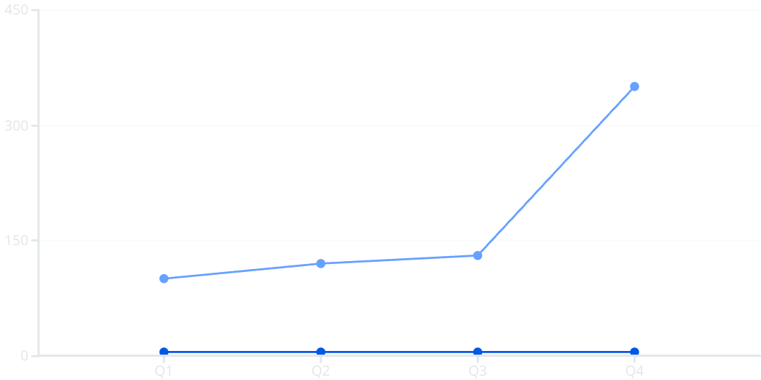
Current Job Market Overview
The global job market continues to showcase dynamic shifts, influenced by economic and geopolitical factors. Currently, the unemployment rate stands at approximately 4.8%, reflecting a moderate decrease from last year’s 5.3%. Despite volatile conditions, nearly 350,000 new jobs were added in the last quarter, signaling positive momentum in employment growth.
Key economic indicators play a crucial role; GDP growth has stabilized around 2.2%, while inflation remains elevated at 6.5%, affecting both job creation and consumer confidence. Global events such as lingering pandemic effects and international tensions have contributed to unpredictable hiring patterns and sector-specific fluctuations.
Unemployment Rate (%)
Jobs Added (Thousands)

Slide 3

Key Job Market Trends
Rise of Remote Work
Remote positions have surged by 40%, transforming how companies recruit and retain talent worldwide.
Automation and AI Impact
While automation has displaced certain routine jobs, it has simultaneously created thousands of new tech and analytical roles.
Gig Economy Growth
The freelance and contract workforce grew by 25%, highlighting the shift to flexible, project-based employment.
Diversity and Inclusion
Companies increasingly focus on fostering diverse workforces, with initiatives improving innovation and employee satisfaction.

Slide 4

In-Demand Skills
Top Hard Skills
Top Soft Skills
Data Science
Communication
Cloud Computing
Leadership
Cybersecurity
Adaptability
Artificial Intelligence
Collaboration
Software Development
Problem Solving

Slide 5
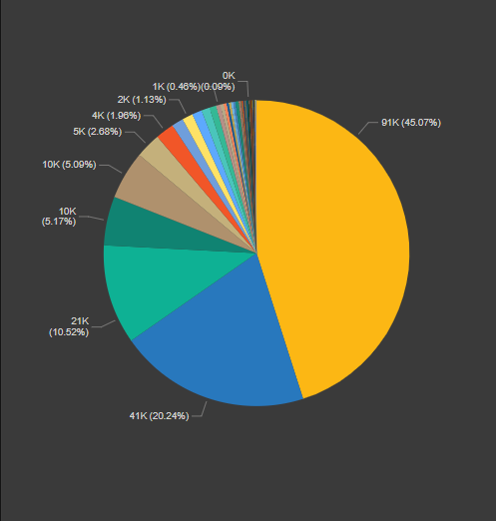







Geographical Hotspots in India for Job Placements
Bangalore
Delhi
Pune
70K Placements
120K Placements
100K Placements
Hyderabad
Mumbai
Chennai
90K Placements
85K Placements
60K Placements
This bar chart highlights leading Indian cities by job placements.
Bangalore leads with 120K placements, followed by Delhi and Mumbai.
These hubs offer diverse opportunities across tech, finance, and services sectors.

Slide 6

Sector Analysis
High-Growth Sectors
Technology
Healthcare
Renewable Energy
Declining Sectors
Retail
Manufacturing
Emerging Sectors
Space Tourism
Sustainable Agriculture
Investment Trends
Strong investments in clean technology and digital infrastructure are driving sector expansion and innovation.

Slide 7


Geographical Hotspots in India
Key cities driving job growth in India and factors influencing employment opportunities.
Bengaluru
Mumbai
Hyderabad
Delhi
Pune
Job growth rates and average salaries vary across regions, influenced by industry hubs like IT, finance, and manufacturing.

Slide 8





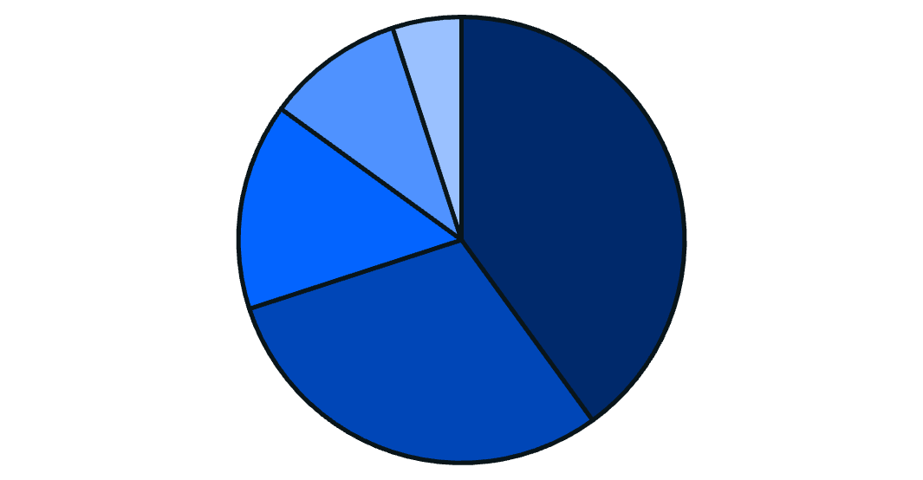
Future Outlook
Job Growth Predictions
Tech Impact
Employment is projected to grow 7% over the next decade, especially in tech and healthcare.
Emerging technologies like AI and robotics will reshape many roles and create new career paths.
1
2
Preparing For Future
Changing Work Nature
Continuous education, reskilling, and strategic career planning will be critical for long-term success.
4
3
Skills such as digital literacy and emotional intelligence will become essential alongside evolving work arrangements.
Technology
Healthcare
Renewable Energy
Education
Other

Slide 9
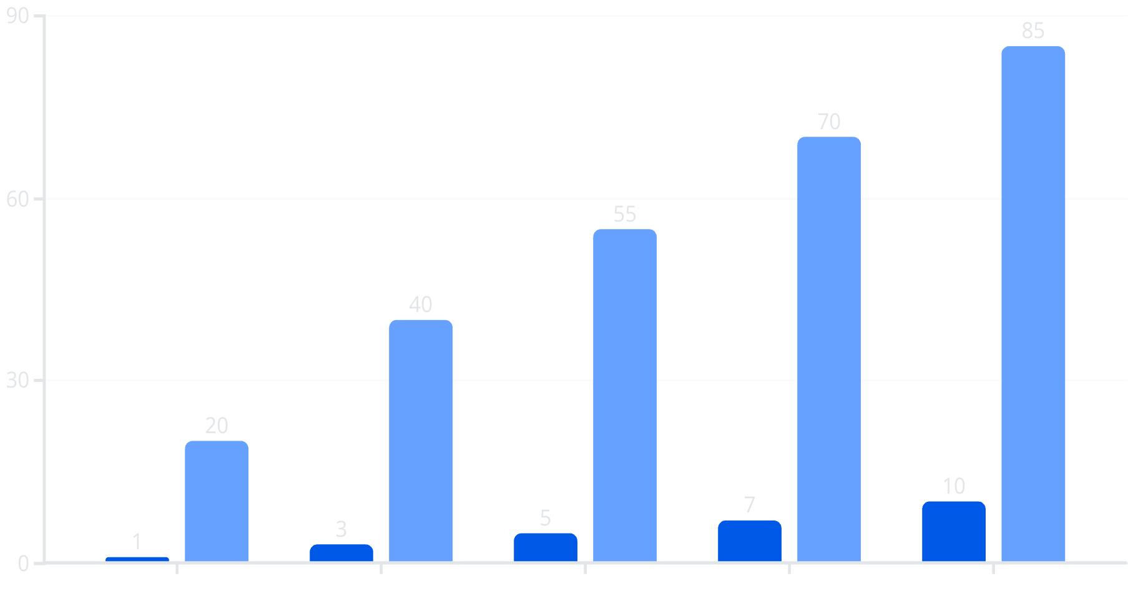

Strategies for Job Seekers
Scatterplot showing correlation between networking efforts and interview success rate.
Resume Optimization
Use ATS-friendly formats and keywords tailored to the job description to stand out.
Interview Skills
Practice the STAR method and behavioral questions for clear, compelling responses.
Networking & Personal Branding
Leverage LinkedIn and industry events to build meaningful connections and showcase expertise.
Negotiation Tactics
Prepare to discuss salary, benefits, and remote work options to maximize job offer value.
Networking Hours per Week
Interview Success Rate (%)
Networking Hours per Week
Interview Success Rate (%)

Slide 10

Conclusion
1
Key Takeaways
The job market remains dynamic with evolving demands and opportunities shaped by technology and global trends.
2
Actionable Steps
Job seekers should focus on skill development, networking, and preparing strategically for the hiring process. Employers must adapt by prioritizing diversity and innovation.
3
Resources
Stay informed through labor reports, industry news, and online career platforms to remain competitive.
4
Final Thoughts
Embracing change and continuous learning is essential for thriving in the future job market.

